Slide 1

Quantitative Strategies
Channel, CMT

Slide 2
Modern Quant
Concept Introduction
1
2
3
4
Fundamental Selection & Back Test
Engine Back Test
TA Examples
Engine Back Test

Slide 3
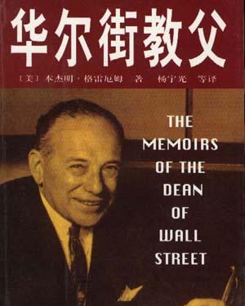
01
Part One
Fundamental Selection & Back Test
Value Investment
Back Test
Empty Strategy
Hedge
Mom Investment
2/8 Transform

Slide 5
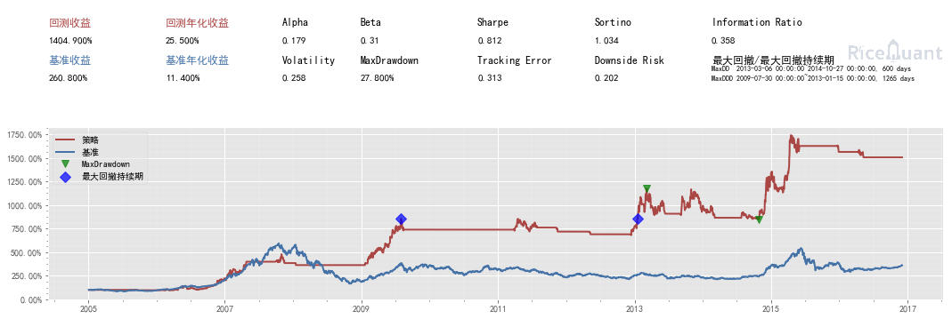
02
Part Three
Engine Back Test
Install
Config
init/handle_bar
history_bars
Order
Scheduler
Completed Strategy
Link: http://act.fxdayu.com/academy/tutorials.html#

Slide 6

03
Part Two
TA Example For Ideas
What is TA?
Moving average
Channel Band
Candle Chart
Momentum
Volume
Relative Strength
Market Breadth
Pattern

Slide 8
04
Part Four
Engine Back Test
MA Pair
Second Break
Bollinger Band
Momentum
Volume
Position

Slide 10

THANKS
Channel, CMT

